Slide 1
Customer demo
JD Edwards Integration
Date: 24-Sep-2023

Slide 2
Intro
The YOUR_COMPANY team were interested to see how kippy could be used to connect to YOUR_COMPANY’s ERP (Oracle JD Edwards) and their other enterprise systems.
This was to help better understand kippy’s capabilities - and also the level of effort required to do integration with the other YOUR_COMPANY enterprise systems.
Therefore, a proof of concept was conducted by the kippy team to connect kippy to a (stubbed) JD Edwards instance, so that the data source could be specified by a kippy end user, but automatically pulled from the appropriate place in JD Edwards (using the JD Edwards APIs).

Slide 3
Outcome
The proof of concept was successful in integrating kippy with Oracle JD Edwards. A demo and technical details of that PoC are provided in this document.
Furthermore, the PoC was completed within a single day – helping provide some indication of the level of effort required per integration.

Slide 4
PoC - Example - Use case
As a stakeholder for sales activity
When a customer is added in the ERP system
I want the updated count of Number of customers to be automatically reflected in kippy
And the Revenue per customer to be automatically re-calculated (using the Total sales revenue from Salesforce)
So that I do not have to duplicate data entry
And can make good strategic decisions based on the latest joined-up information from various systems

Slide 5
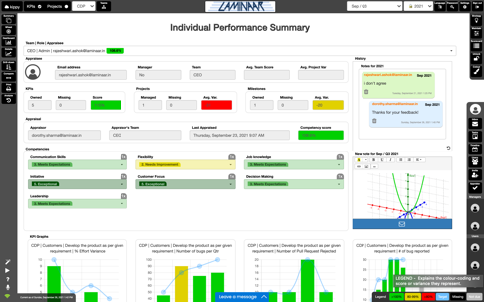
Background
ERP User
Kippy Users
1. Business user makes change in YOUR_COMPANY’s JD Edwards ERP
2. Change in ERP is pulled from Kippy via web APIs
3. Data is mapped to team KPIs - and ‘merged’ with other automatic and manual sources using formulas.
4. Kippy users view team level performance reports on re-calculated scores.
A successful proof of concept was conducted so a change in JD Edwards would automatically flow to kippy – and be used in a formula mixed with other sources – to present a recalculated score.

Slide 6
Solution Overview
secure, stable, monitored
Dedicated kippy cloud instance for YOUR_COMPANY
YOUR_COMPANY Systems
Kippy users
Integrated identity management
Internal Identity systems
USER
INTERFACE
IDENTITY
MGMT
Existing Systems
(JD Edwards)
ERP User
Secure system to system integration
Scheduler
JD Edwards
Adapter
Web APIs
Stub

Slide 7
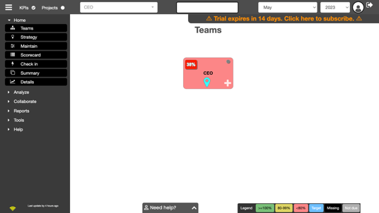
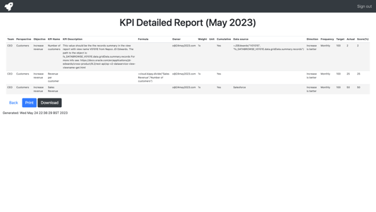
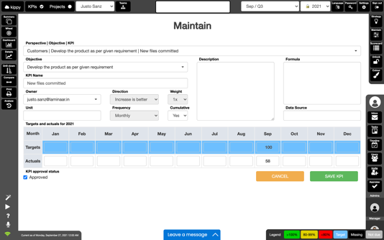
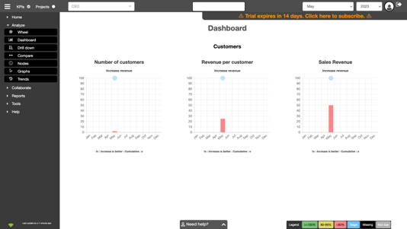
Technical POC Output
1. Kippy instance created for YOUR_COMPANY
2. KPIs created for Total sales revenue (from Salesforce) and Number of customers (from JD Edwards)
3. Third KPI created to calculate Revenue per customer
4. YOUR_COMPANY ERP user adds another customer in YOUR_COMPANY ERP
5. Number of customers is updated and saved in JD Edwards
Kippy’s JD Edwards
Adapter
Scheduler
6. Scheduler invokes Kippy JD Edwards Adapter
7. For all KPIs where the data source is JD Edwards, the adapter calls JD Edwards (using the data source parameters)
8. YOUR_COMPANY’s JD Edwards returns the requested latest info
9. Kippy persists retrieved info into Number of customers KPI and recalculates Revenue per customer
8. All dashboards and reports auto-updated in seconds

Slide 8
Appendix

Slide 9
Approach for technical POC
Set up kippy with 3 KPIs (Number of customers, Total sales revenue, Revenue per customer)
Created a local stub to return payload for the JD Edwards Simple View Query v2 API (as per documented specification)
Create a primer for the stub to simulate a customer being added to JD Edwards (hence incrementing the summary records number in the returned payload)
Created a Kippy adapter that
a) finds all KPIs with data source =JD Edwards
b) gets the parameters in the KPI’s data source (i.e. view name and json path)
c) makes a call to the JD Edwards Simple View Query v2 API (e.g. using the view name as a query parameter)
d) finds the value at the specified json path in the returned payload
e) sets the KPI actual with that value
5) Kippy then automatically re-calculates the Revenue per customer (i.e. divide Total sales revenue by Number of customer)

Slide 10
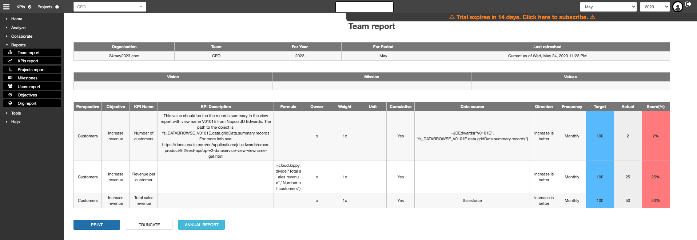
Kippy set up
Three KPIs created in KPI.
- Number of customers data source =JDEdwards("V0101E","fs_DATABROWSE_V0101E.data.gridData.summary.records")
- Total sales revenue entered manually (but could also be pushed/pulled)
- Revenue per customer formula =cloud.kippy.divide("Total sales revenue","Number of customers")

Slide 11
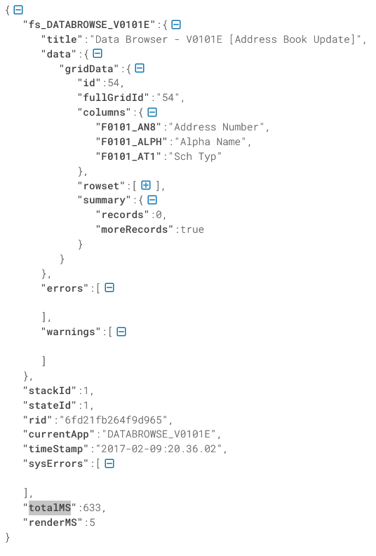
JD Edwards stub
A local JD Edwards stub was created for the API Simple View Query v2

Slide 12
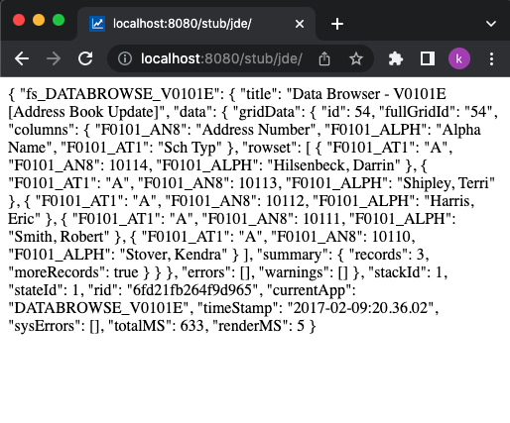
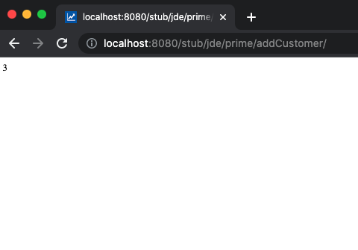
JD Edwards stub
The stub could be primed by invoking a local url to increment the number of customers
fs_DATABROWSE_V0101E.data.gridData.summary.records

Slide 13
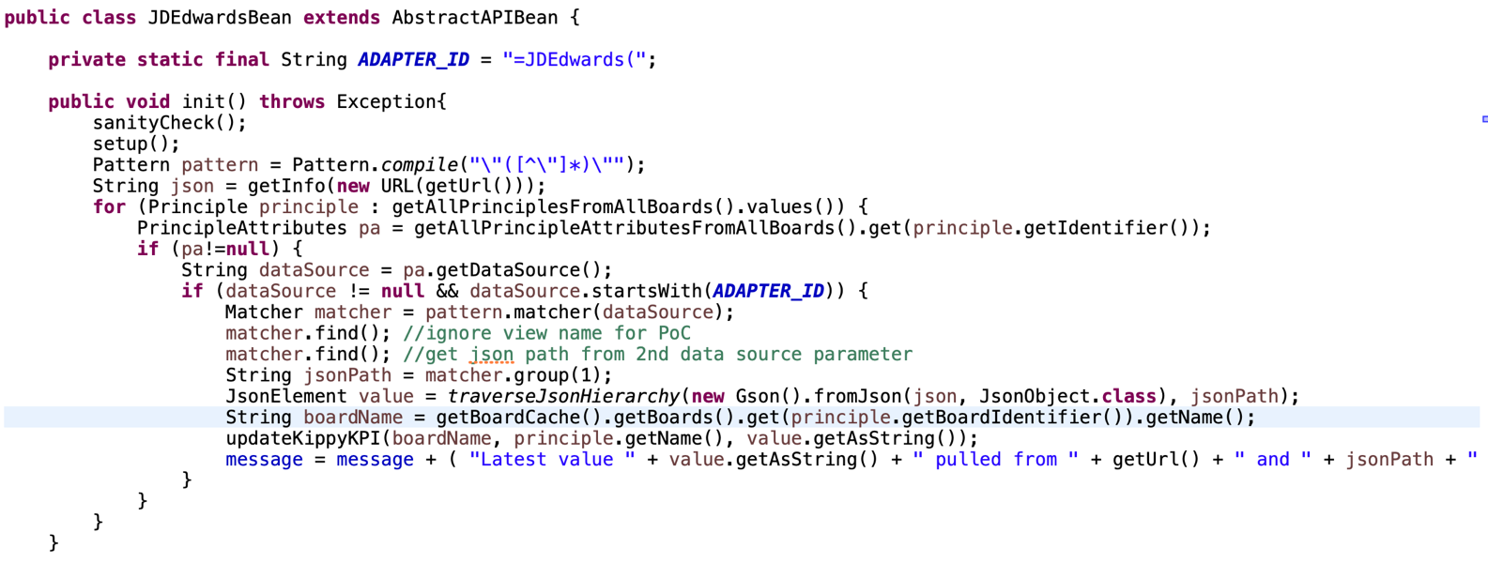
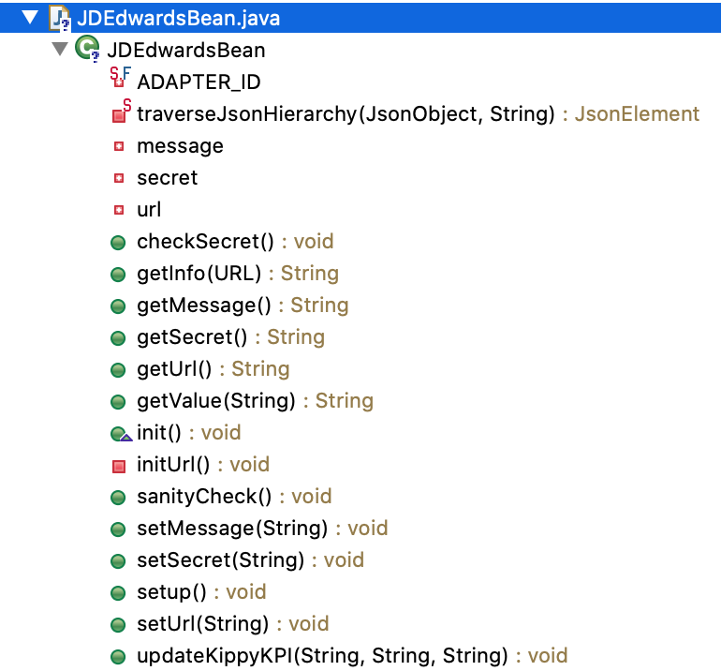
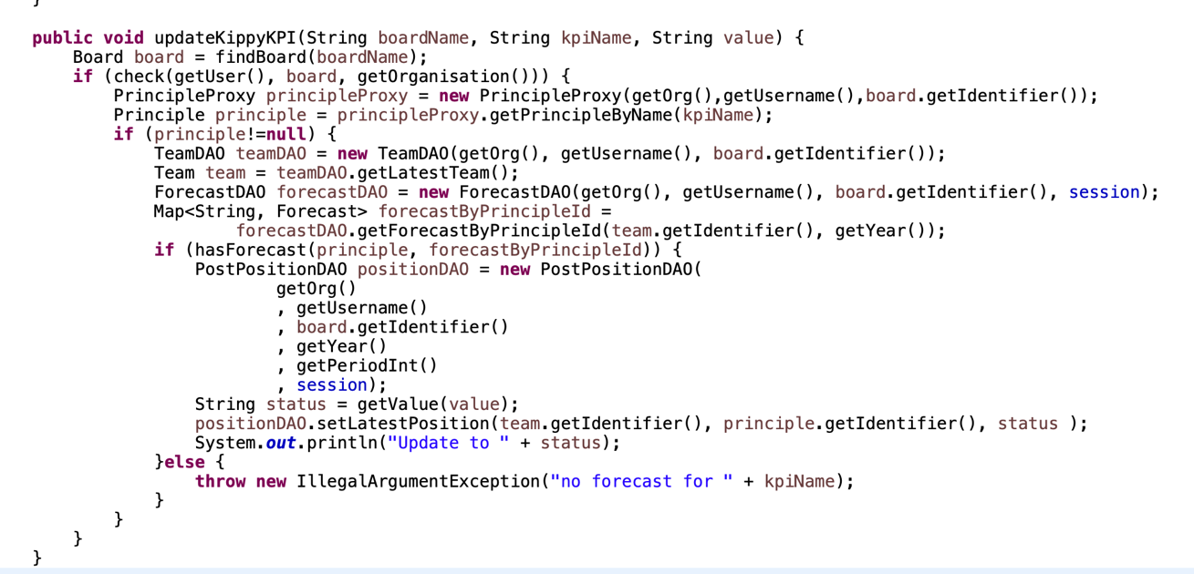
Code for Kippy JD Edwards adapter

Slide 14
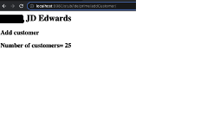
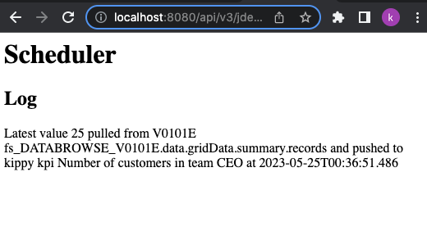
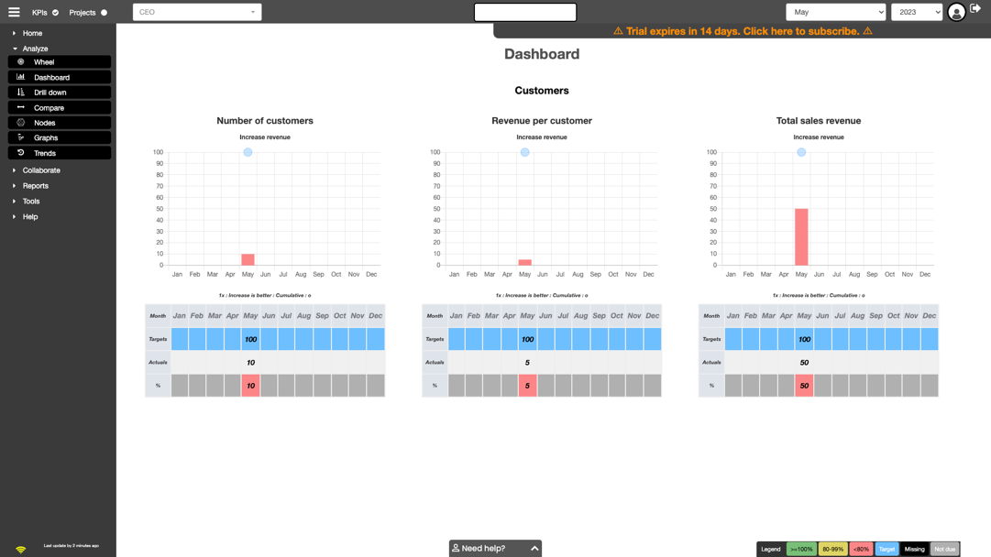
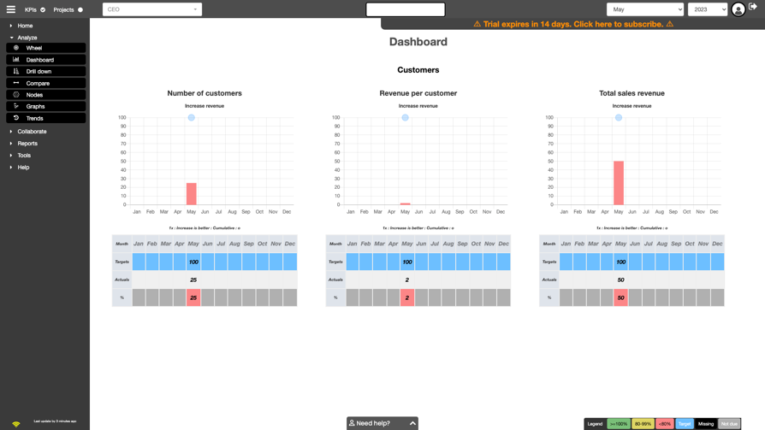
Auto-update and auto-recalc
Step 1: Before
Number of customers = 10
Total sales revenue = 50
Revenue per customer = 5
Step 2: Add customers
15 new customers added (in stub)
Number of customers 25.
Step 3: Run Adapter
Schedule runs adapter
Step 4: Auto-refresh & auto-recalculation
Number of customers = 25
Total sales revenue = 50
Revenue per customer = 2

Slide 15
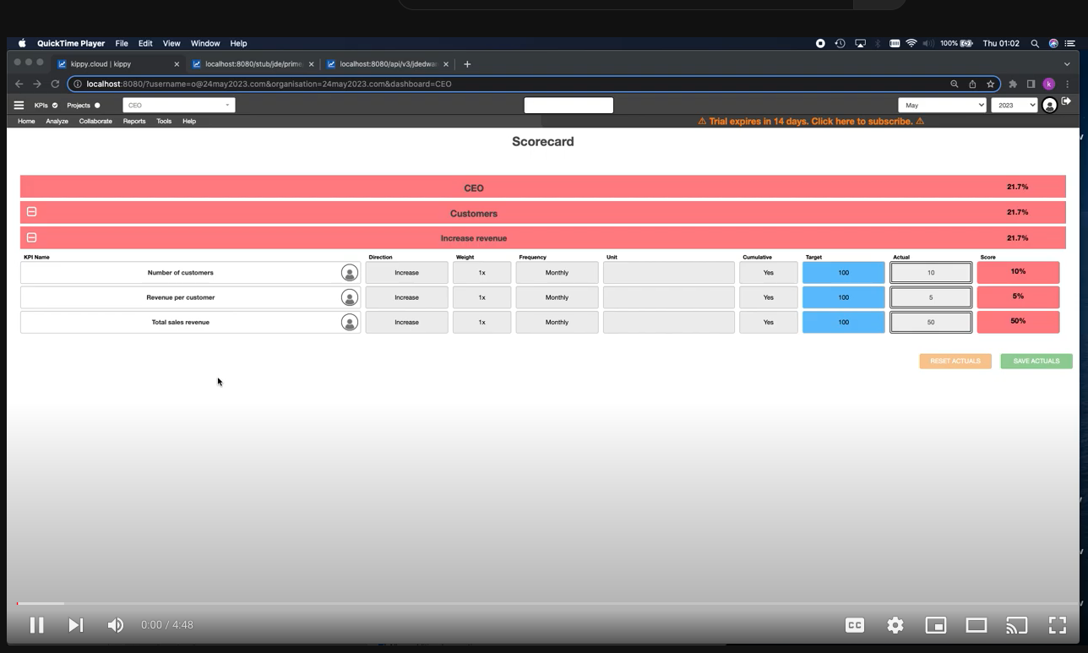
Recorded demo
https://youtu.be/vYVJxNeJE74

